Slide 1


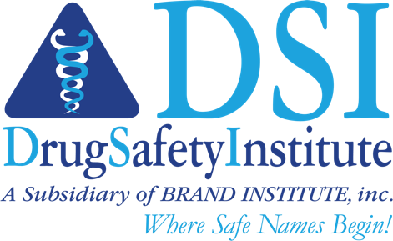

LOGO DEVELOPMENT
October 23, 2024
Project: OCS01LOGO
BASEL BOSTON CHICAGO DALLAS FRANKFURT LONDON LOS ANGELES MIAMI MONTRÉAL MUMBAI
NEW YORK OTTAWA RALEIGH ROCKVILLE SAN FRANCISCO SAN JUAN SÃO PAULO SEOUL TOKYO TORONTO
Proprietary & Confidential

Slide 2
Product Description
DME:
OCS-01, an OPTIREACH® formulation of high concentration dexamethasone eye drop, has the potential to become the first non-invasive treatment option for DME to address unmet medical needs for both earlier treatment intervention and for the treatment of suboptimal responders to anti-VEGF therapies, the current standard of care.
The OPTIREACH® solubilizing formulation technology addresses the main limitations of conventional eye drops by improving the solubility of lipophilic drugs, increasing the residence time on the eye surface and thereby, enabling less frequent administration for front-of-the-eye and the drug passage from the eye surface to the posterior segment for back-of-the-eye diseases.
Big unmet need for early treatment intervention
Topical Eye Drop, first time for DME that has shown effectiveness
Patient Benefit: self-administration, being in control
Post-Ocular Surgery:
The OPTIREACH® solubilizing formulation technology addresses the main limitations of conventional eye drops by improving the solubility of lipophilic drugs, increasing the residence time on the eye surface and thereby, enabling less frequent administration for front-of-the-eye and the drug passage from the eye surface to the posterior segment for back-of-the-eye diseases.
OCS-01 will be the first once-daily, high concentration, preservative-free steroid eye drop for treating inflammation and pain following ocular surgery.
Innovative and penetrates (and treats) retina

Slide 3
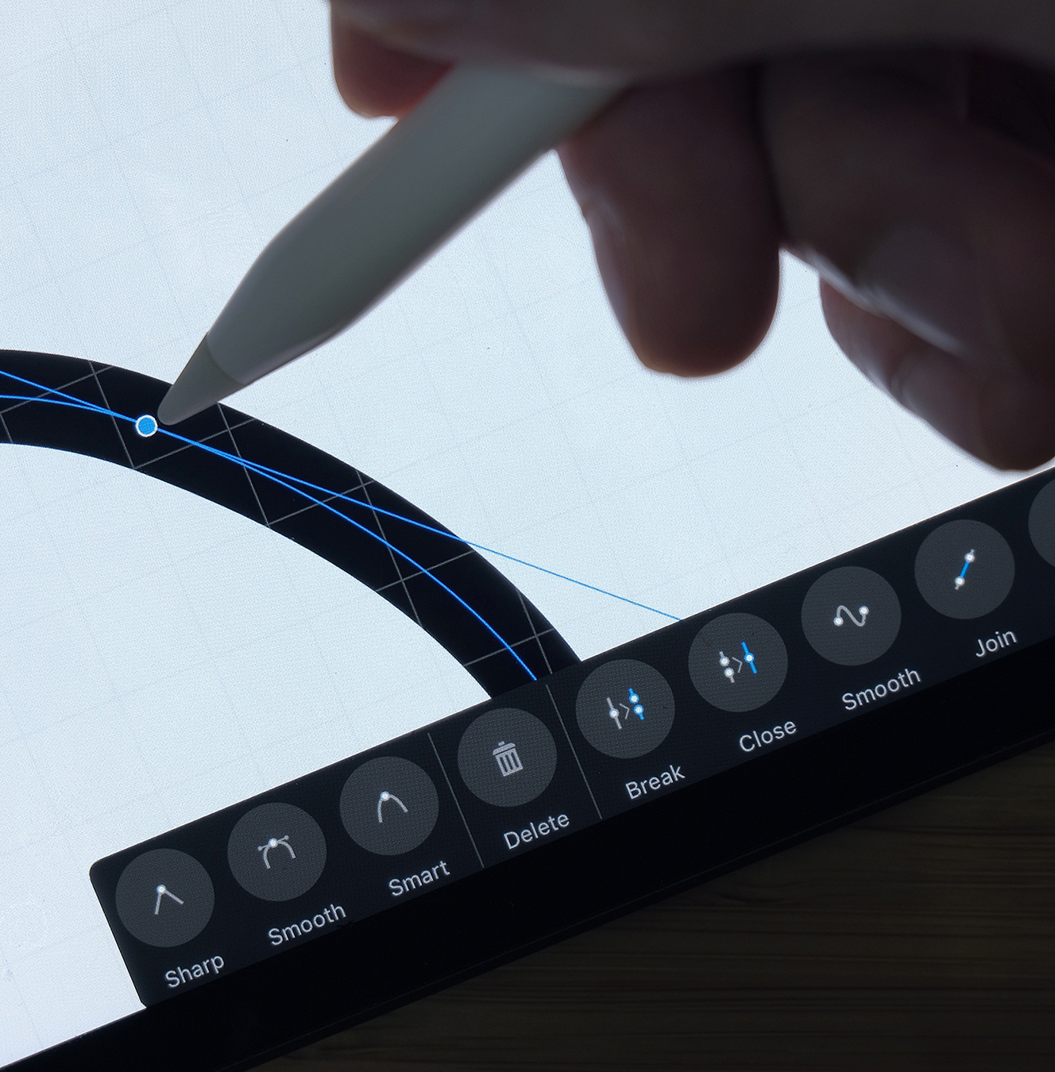


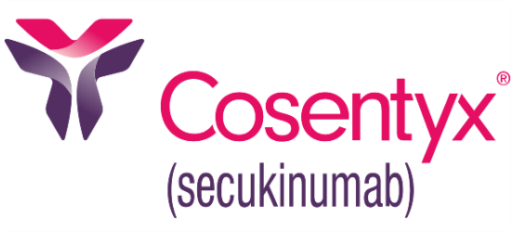

What should we explore ?
It needs to convey the benefit of the product:
Patient Benefit: self-administration, being in control
Topical Eye Drop, first time for DME that has shown effectiveness
Big unmet need for early treatment intervention
Embedded in logo but has meaning
Stand alone in front of the name (Cosentyx and Humira style)
No eye-drop (as it’s in the Corp logo)
Icon into the name representing going through layers (but not pointy or injection-like)
Icon drop on A (as provided below)
Options for both VUSJA and VuSja capitalization
No Angles/Pointy
Highly concentrated and potent steroid (not too soft)
Try multiple fonts (thick and thin)
Modern and Sleek (Cosentyx)
Direct meaning of the of the imagery needs to be conveyed. Avoid abstracts
Multiple lines conveying layers of the eye
Roundness to it but modern
Creative Direction

Slide 4

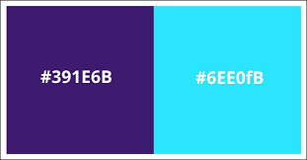
Concepts to Avoid
Eye drop
Oculis logo
Spacing between letters very close
Avoid colors yellow and orange
No waves
Logo needs to be distinct from current corporate logo
Color to Explore
Space has a lot of blue, try and be different
Single color for the brand name
Green, but not soft or yellow-green (try and avoid relating to renewable energy and the likes) (think Keytruda)
Northern Lights inspiration
Green-Purple combo
Deep Pink, Purple (think Cosentyx)
Creative Direction

Slide 5
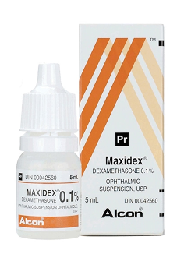
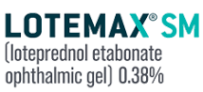
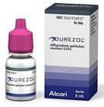

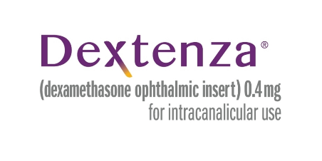
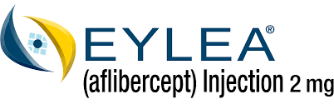

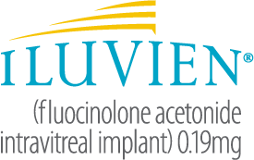
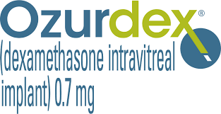
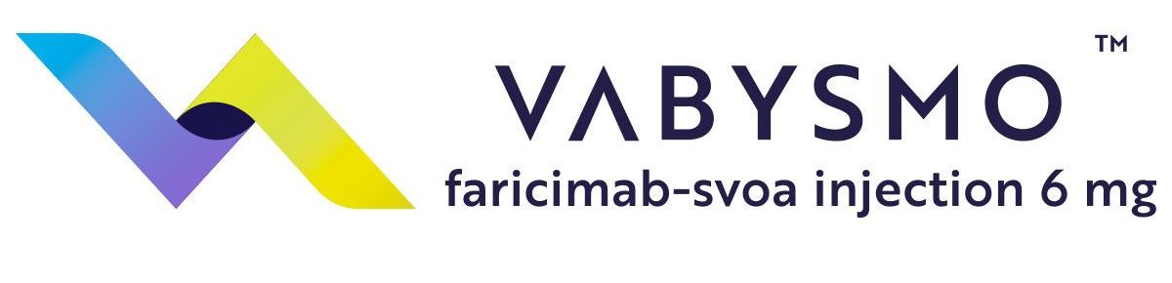
Competitive Landscape

Slide 6
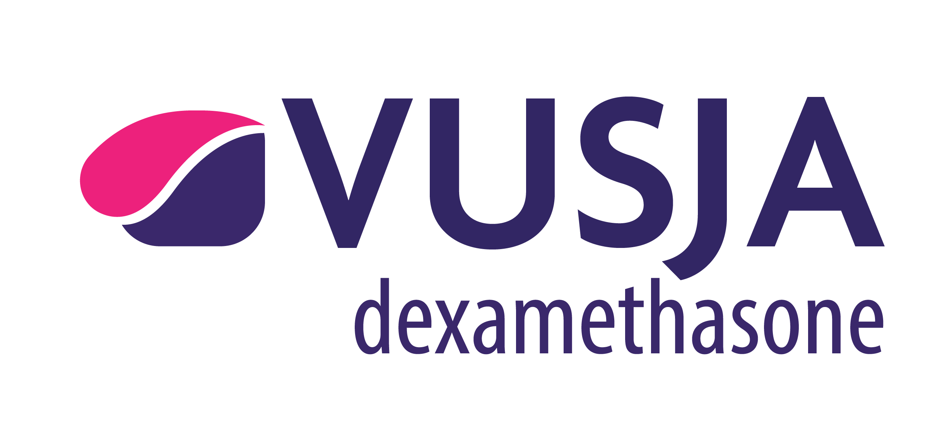
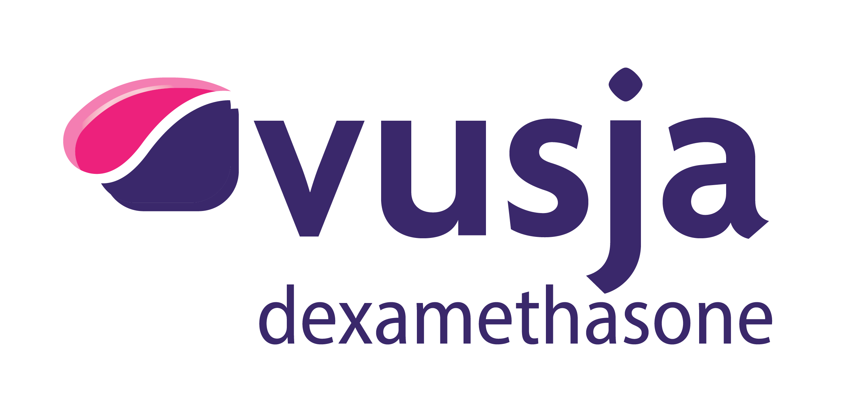


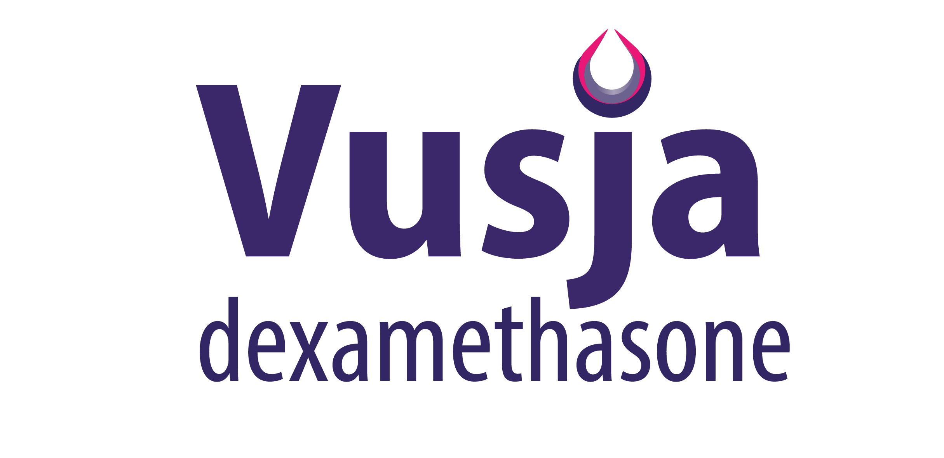
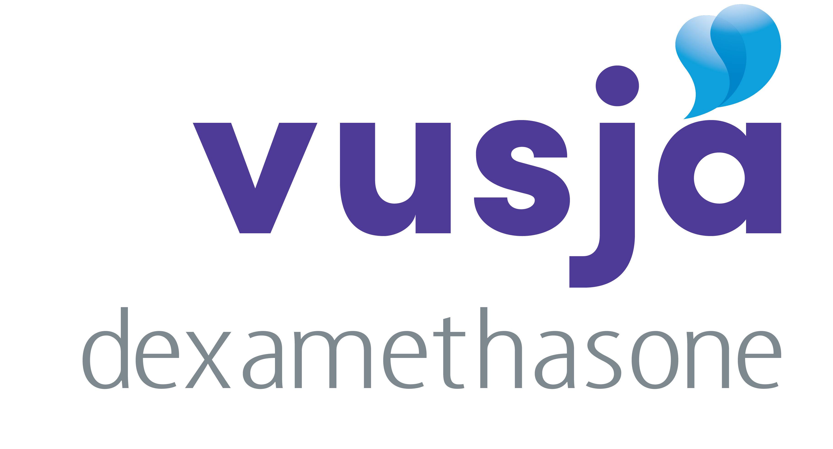
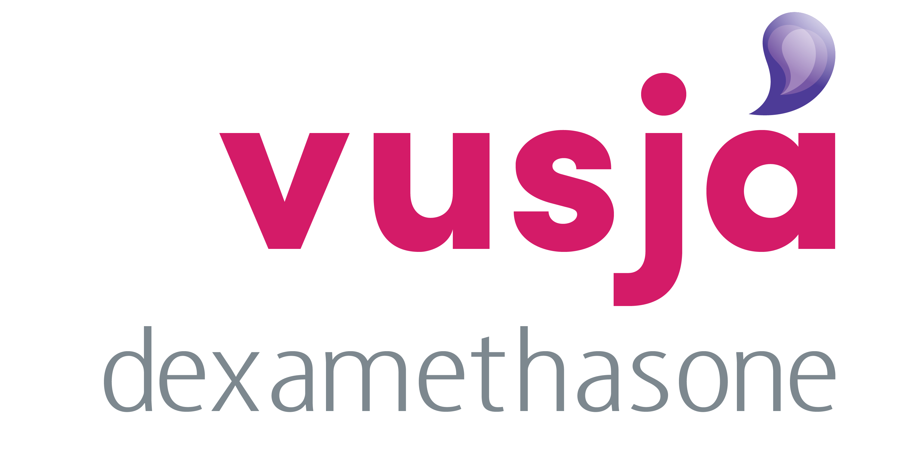
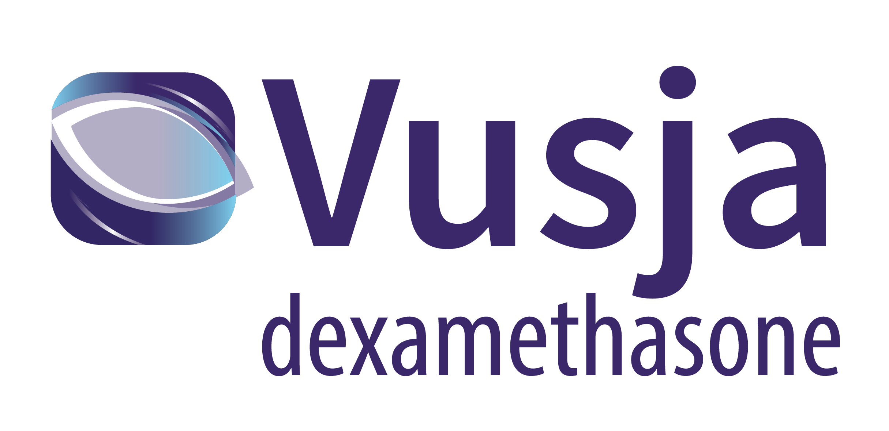
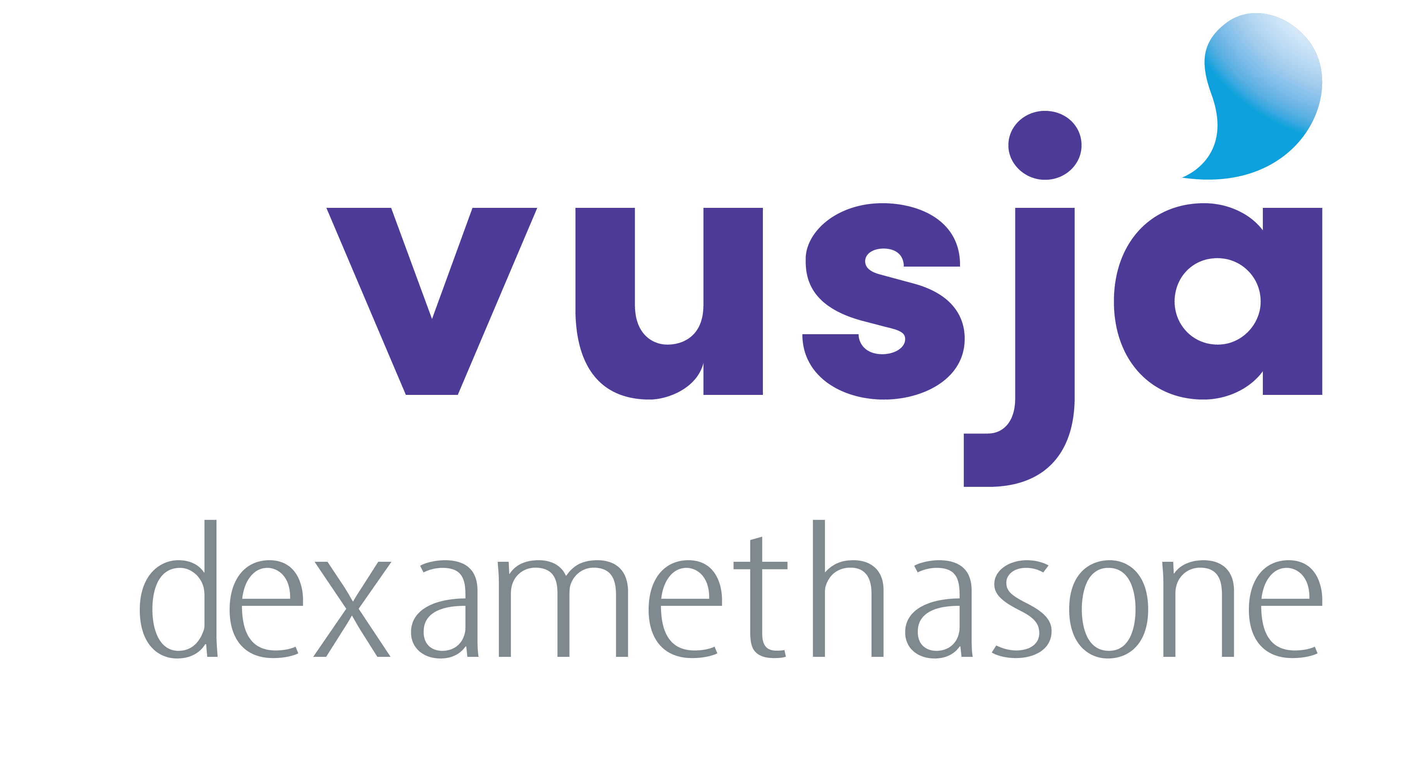
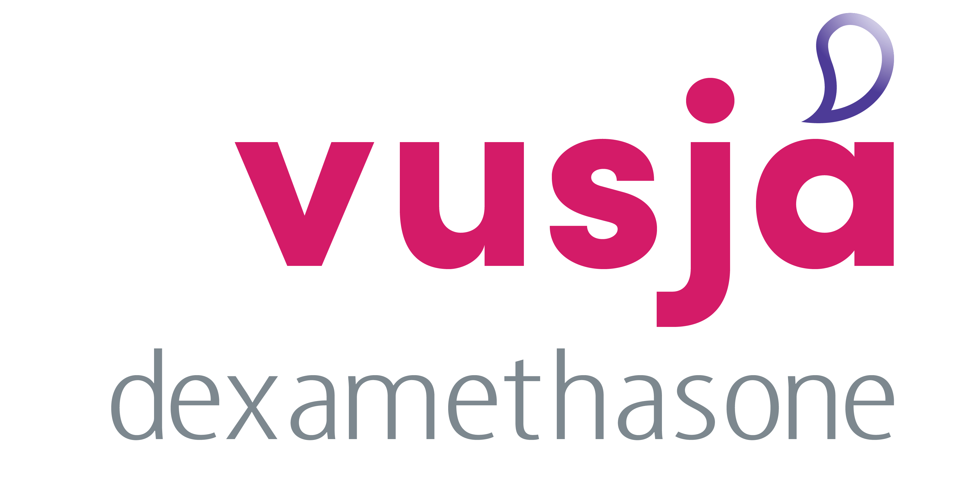


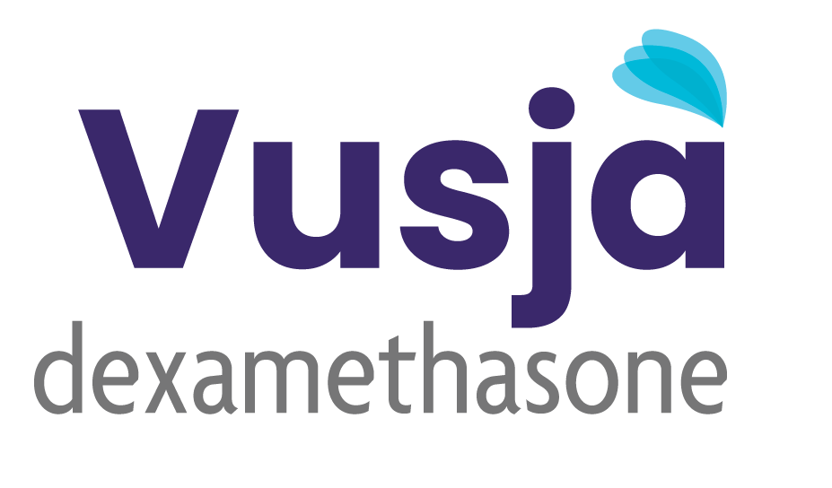
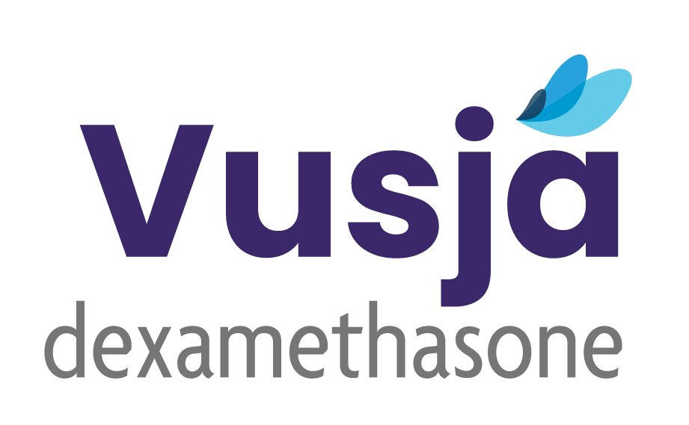

Summary
1A.
1B.
1C.
1D.
2.
3.
4A.
4B.
4C.
4D.
5A.
5B.
6A.
6B.
6C.

Slide 7
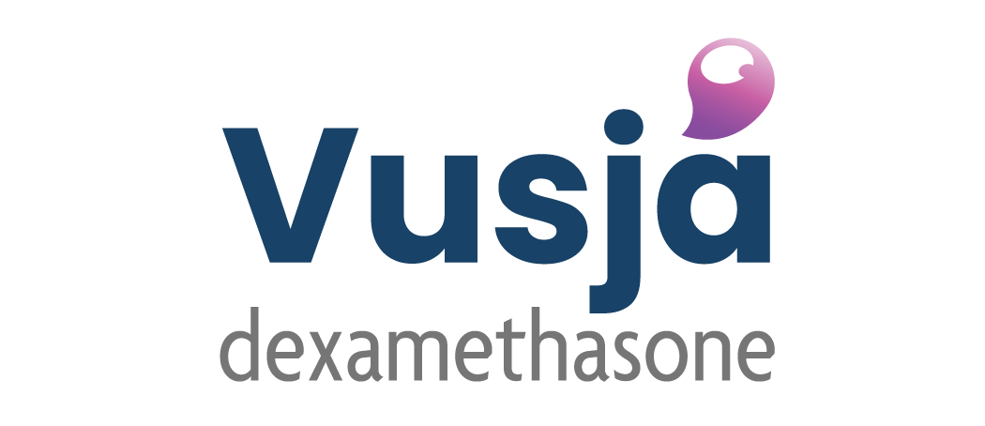


Summary
7.
8A.
8B.

Slide 8

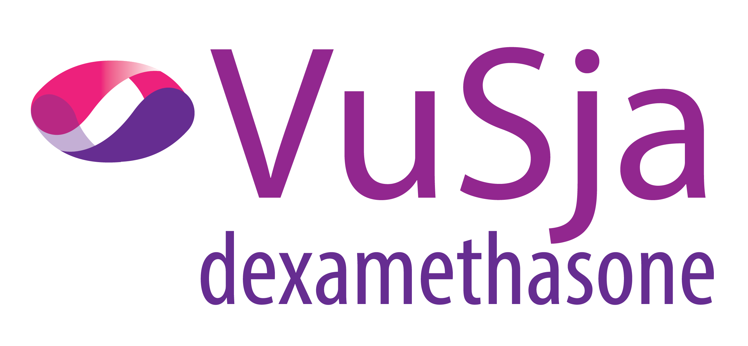
Option 1
A.
B.
C.
D.
Inspiration | The symmetrical intersecting circles in perspective symbolize the power of collaboration and effective communication.

Slide 9

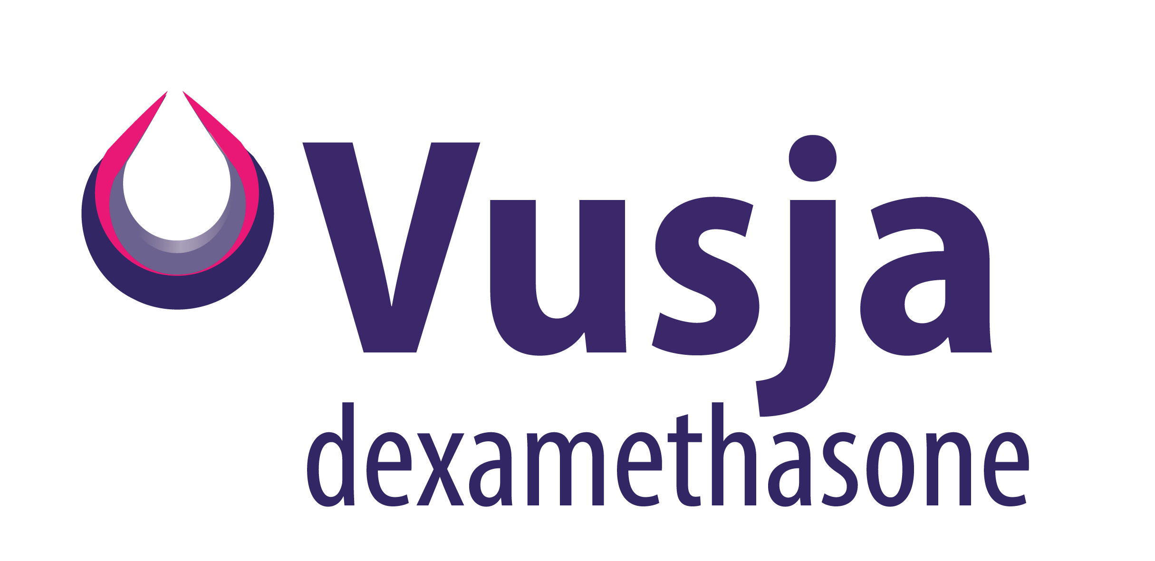
Option 2
Marketing Logo
Packaging Logo
Inspiration | The design concept of depth gradient in perspective symbolizes penetrating insight and clarity

Slide 10
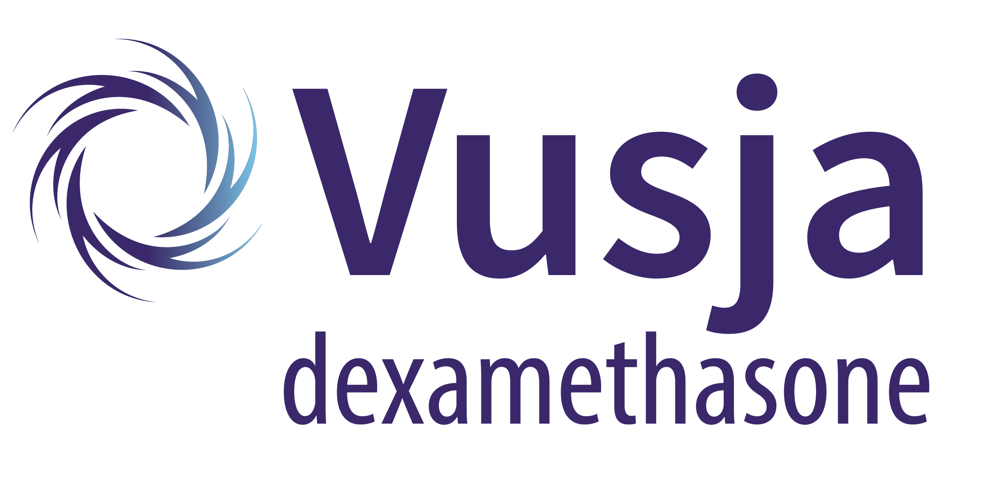
Option 3
Inspiration | The design concept of rotating arrows symbolizes penetrating force and effectiveness.

Slide 11
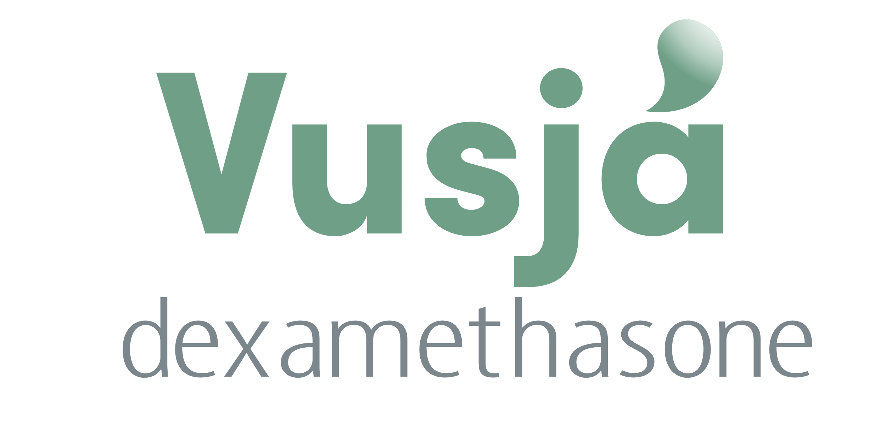
Option 4
A.
B.
C.
D.
Inspiration |A simple word mark with a water drop on the letter "A"

Slide 12
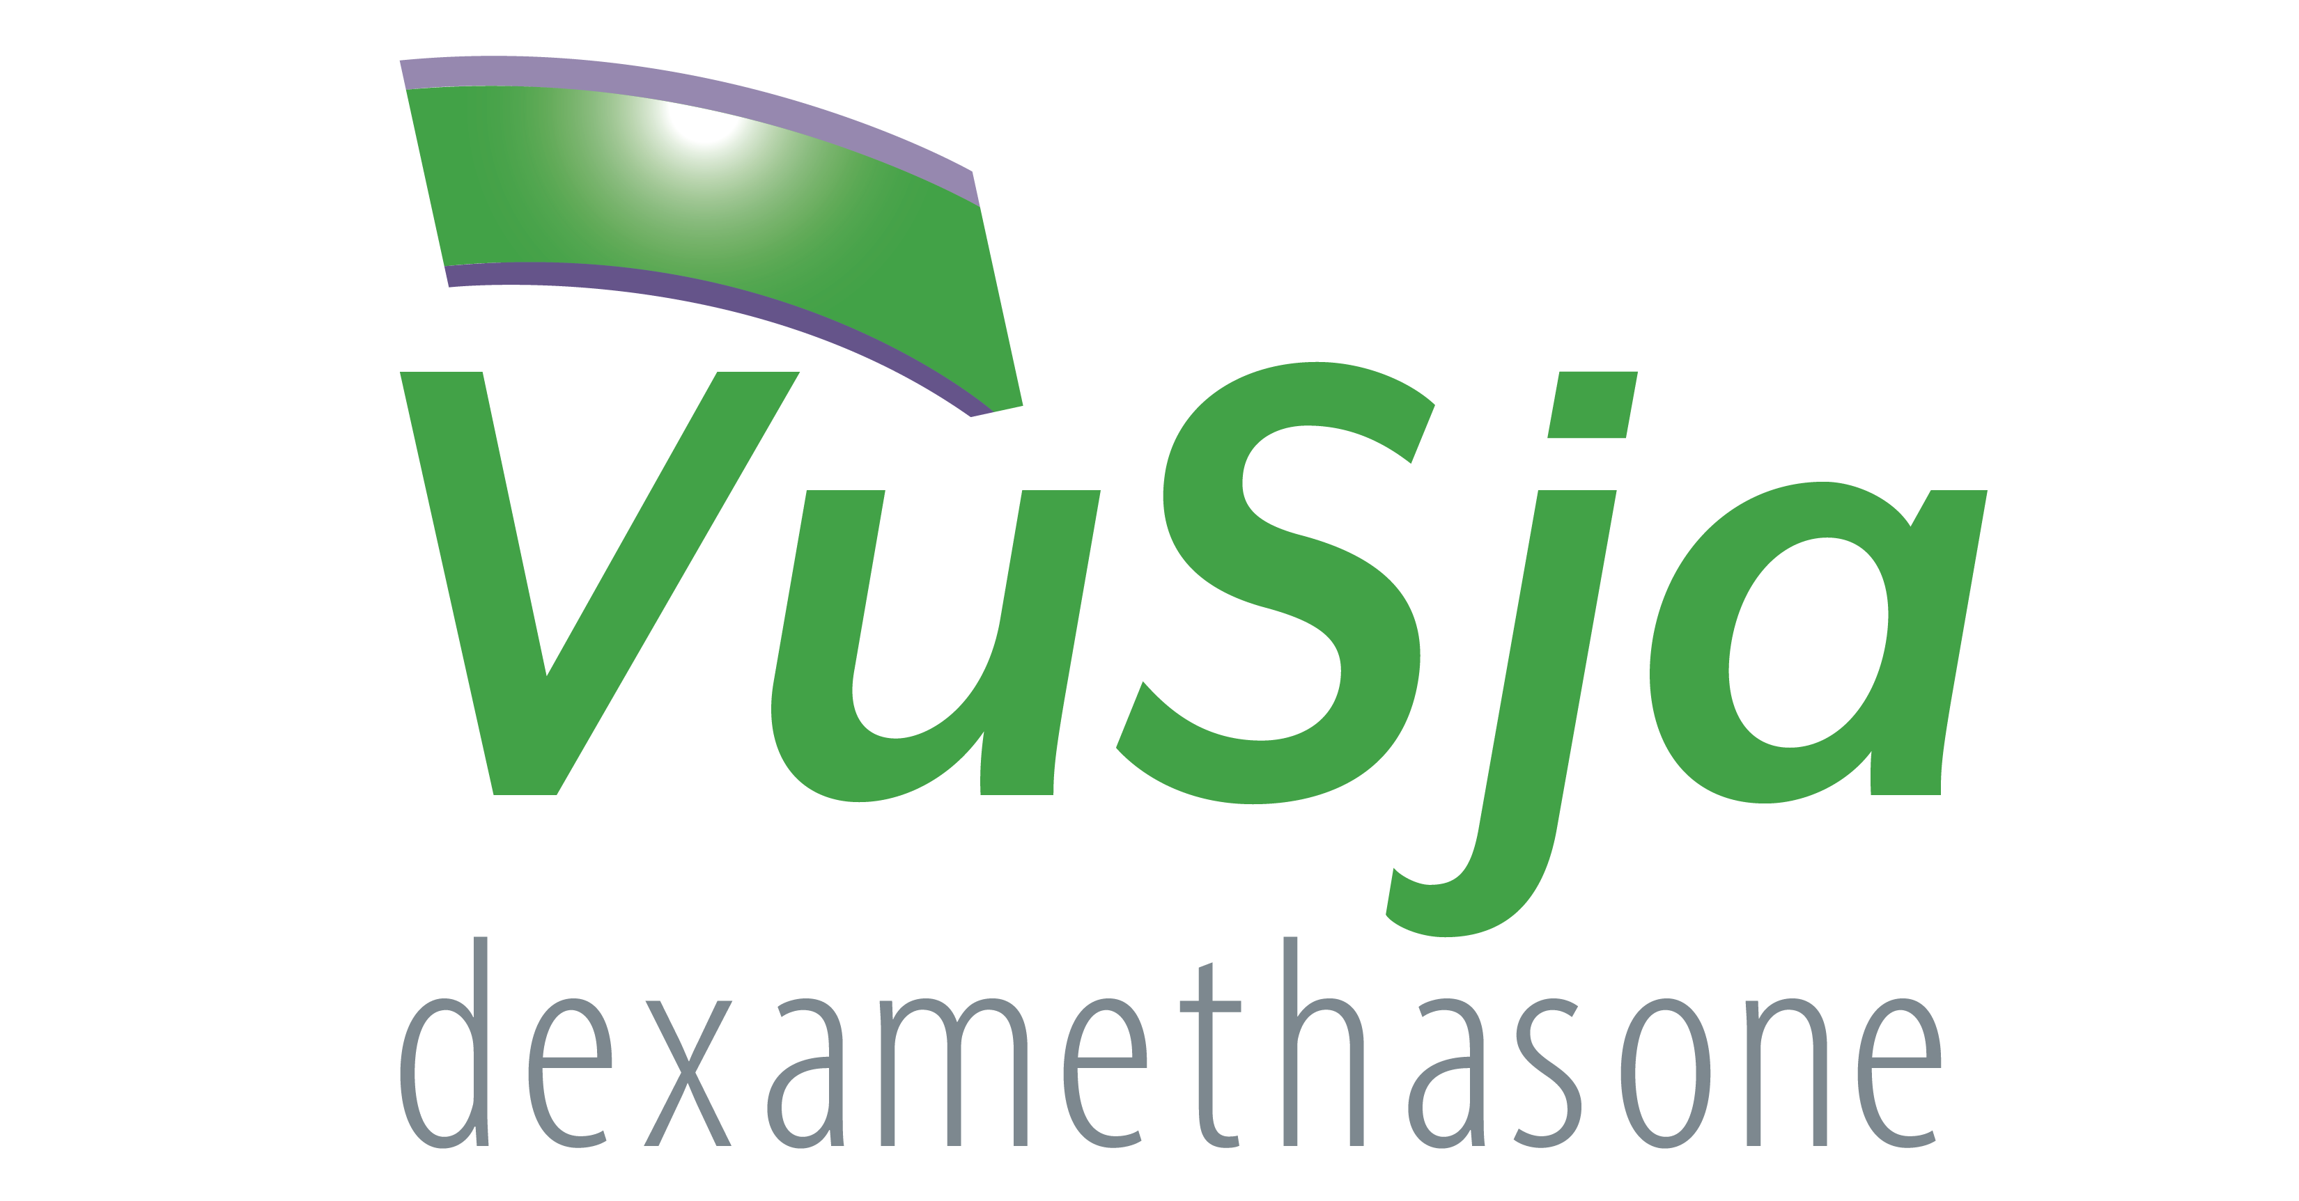
Option 5
A.
B.
Inspiration | An abstract shape to show the different layers of the cornea.

Slide 13
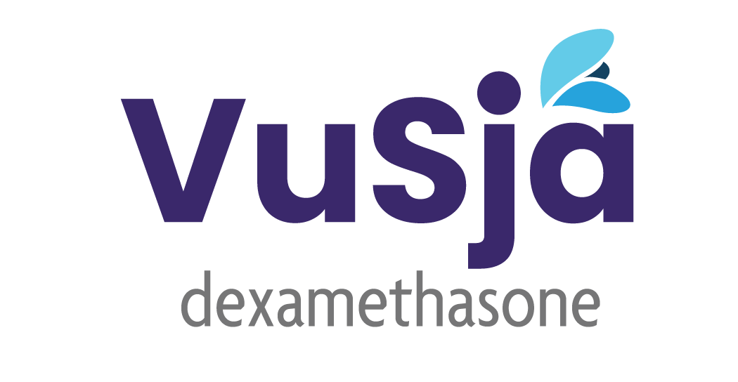
Option 6
A.
B.
C.
Inspiration |Minimalist drop approach to show clarity and effectiveness of the product.

Slide 14
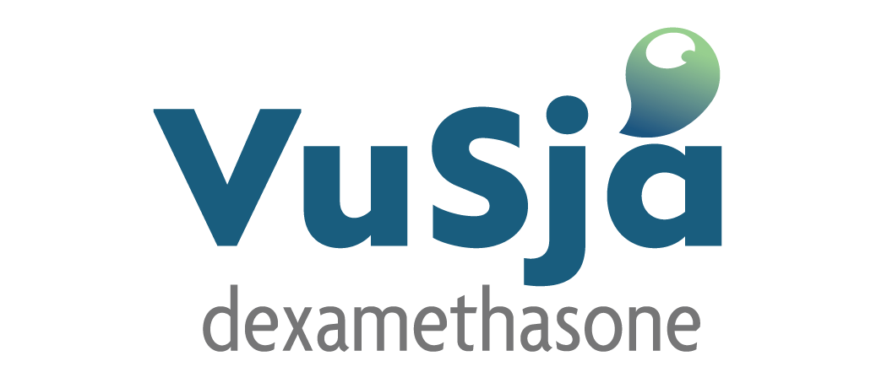
Option 7
Inspiration |Minimalist drop icon on letter 'A' on the wordmark .

Slide 15


Option 8
Marketing Logo.
Packaging Logo.
A.
B.
C.
Inspiration | Icon symbolizes going through layers.

Slide 16
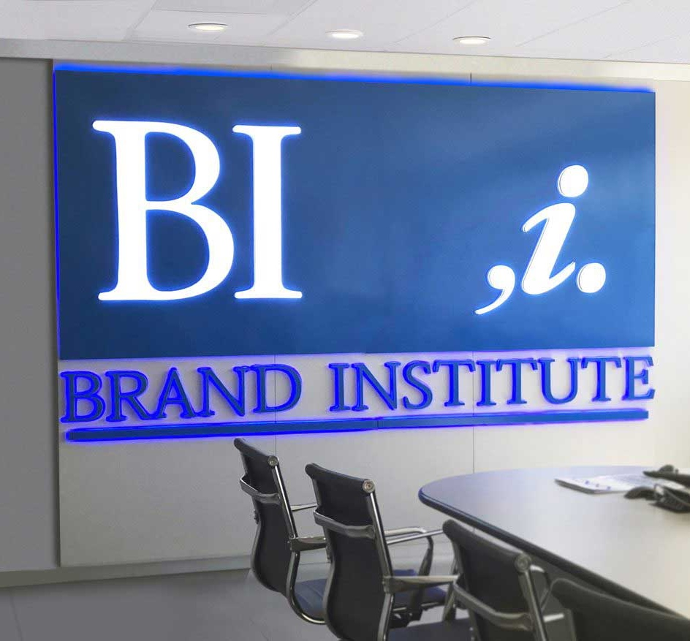
Thank You!
Thank you for your participation! Your referrals are the best compliment. Should your colleagues have questions or naming needs, please feel free to forward the contact information below:

